Slide 1
Course Introduction
Welcome to ENGL 3110

Slide 2
Review
Punctuation for PHRASES
  No comma needed for two phrases of any kind
    Bob and Jim run.
    Bob and Jim run and jump.
    Bob and Jim throw balls and frisbees but chase cars and ducks.
    Bob and Jim throw balls and frisbees but chase cars and ducks on Sundays and on holidays.
    Bob and Jim throw balls and frisbees but chase cars and ducks on Sundays and Mondays and on holidays.

Slide 3
Review
Punctuation for PHRASES
  Needs a comma when you have THREE Phrases (a list)
    Bob, Jim, and Pam run.
    Bob and Jim run, jump, and skip.
    Bob throws balls, frisbees, and javelins.
    Bob throws balls, drive cars, and chase ducks.
    Bob chases ducks on Sundays, Mondays, and holidays.

Slide 4
Review
Punctuation for CLAUSES
  These rules change dramatically when you have clauses
    Clauses are “sets” of subjects and verbs.
    Clauses have a new “S” at the top.
    Clauses for declarative sentences always have at least one subject and at least one verb.
  Two Phrases:
    Bob and Jim run and skip.
  Two clauses
    Bob runs, and Jim skips.

Slide 5
Review
Coordinating Conjunctions (FANBOYS)
  Make Compound Sentences
    I like ice cream, and I like cake.
    And I like cake, I like ice cream.
Subordinating Conjunctions (pass the flip test)
  Make Complex Sentences
    I like ice cream when I eat cake.
    When I eat cake, I like ice cream.
Conjunctive Adverbs (However, Also)
  Make Two Simple Sentences
    I like ice cream. Also, I like cake.

Slide 6
Review
Coordinating Conjunctions (FANBOYS)
  Make Compound Sentences
    I like ice cream, and I like cake.
Subordinating Conjunctions (pass the flip test)
  Make Complex Sentences
    I like ice cream when I eat cake.
    When I eat cake, I like ice cream.
Conjunctive Adverbs (However, Also)
  Make Two Simple Sentences
    I like ice cream. Also, I like cake.

Slide 7
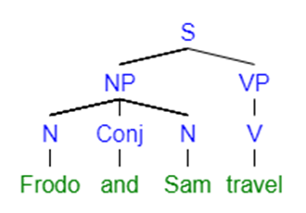
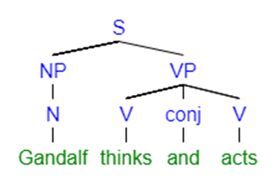
Two Phrases with a Conjunction

Slide 8
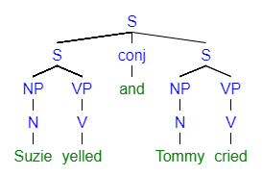
Two Clauses with a Coordinating Conjunction

Slide 9
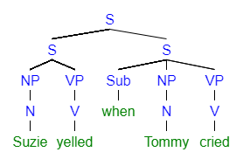
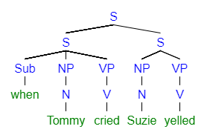
Two Clauses with a Subordinating Conjunction

Slide 10
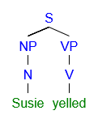
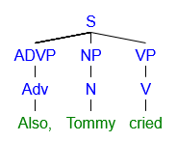
Two Clauses with a Conjunctive Adverb

Slide 11
Clarification and Application
One Good Question from Every Student
Practice Sentence Building and Editing on White Board
Application Discussion

Slide 12
Clarification and Application
One Good Question from Every Student
Questions by Preference
  Something you still don’t get from the last test.
  Something you need to understand for the next test.
  Something about the class itself (shopkeeping)
  Anything we discussed or read that confused you.
  General grammar questions you have encountered before.
  Something about UCCS, Degrees, Career Plans, etc.
  Something you are curious about.
  Something you want to know about Phillip or the class

Slide 13
Clarification and Application
Diagram on White Board
  Diagram one sentence of each type below.
  After diagramming, add at least three additional words or elements
Sentence Types
  Copular Be or Linking
  Ditransitive
  Compound
  Complex

Slide 14
Clarification and Application
End Weight vs Front Weight
  Sentences are easier to read when weight is at the end (big part last).
  Despite the fact that many schools line up eagerly at the trough to accept huge donations from disreputable donors and invest their funds heavily in the stock market by purchasing ownership in dubious companies opposed to the inherent principles of the academy, Universities still pretend to be the arbiters of the nation’s ethics

Slide 15
Clarification and Application
There is/There Are
  Sometimes useful but often obscures the actor.
  There are some students who just brighten up your day.
    Some students just brighten your day.
  There is a theory by Chomsky that argues that the ability to learn a language declines after puberty.
    Chomsky theorizes that the ability to learn a language declines after puberty
  There are many reasons to agree with that plan and few reasons to object.

Slide 16
Clarification and Application
Ambiguous Pronouns
  Pronouns must link to an “antecedent”
    “It” = “the experience of waiting patiently at a drive through”
Strategy One = Replace with Noun
    This has caused many problems.
    Our tribal urge to protect our own has caused many problems.
Strategy Two = Pronoun becomes Determiner
  That was rejected by the team.
    That plan was rejected by the team.
  This slowed our efficiency by 20%.
    This new editing process slowed our efficiency by 20%

Slide 17
End of Class
If you have questions or concerns, hang around to talk.

